Slide 1
Deploying machine learning models to AWS Lambda
Praveen Taneja

Slide 2
Agenda
A personal project I did a while ago
Why is this interesting?
Steps for Doing It Yourself

Slide 3
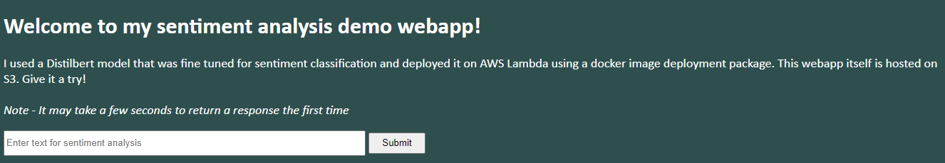

Serving real time insights from a machine learning model through a webapp
Note - Sentiment model predictions are highly skewed towards +/-1
Webapp Link
This model is from Hugging Face which has many other interesting state of the art models on NLP, computer vision, audio, etc that you can fine tune and deploy! You can also deploy your own models using the steps discussed in this presentation.

Slide 4
Why is this interesting?
Productizing an ML model is key to delivering value at scale.
Data science model is an important, but a small piece of the whole pipeline. Familiarity with different parts of the pipeline helps one understand practical constraints (model size, prediction latency, scaling, etc) and become a more full stack data scientist.
It is fun to be able to deploy models that others can use!
Because of time constraints, I will give an overview of the steps. To get the most out of it, follow the instructions in this slide deck to deploy yourself and let me know if you face issues!

Slide 5

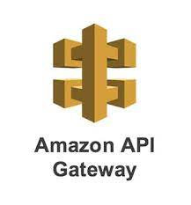




Architecture diagram - How does the information flow?
AWS
API response
API response
Lambda - Runs user code, Fully handles needed infrastructure
API request
API request
Container - Code + dependencies
ECR - Hosts Docker
Images
S3 (general file storage, static web hosting - for webpage it stores index.html, CSS)
API gateway - Check permissions, routing, logging API requests/responses

Slide 6
Getting started with AWS
Create a free AWS account. This account has root privileges.
Turn on Multi Factor Authentication
Create monthly budgets and billing alerts to avoid charges
Create IAM non-root accounts for regular use and giving access to other services
Install AWS Sam CLI automates most of the deployment - note the link includes pre-requisite steps listed above
Really indepth AWS course - https://learn.cantrill.io/p/aws-certified-solutions-architect-associate-saa-c03

Slide 7
Set up code
Use AWS Sam Init that has guided choices and ends with creating a starting folder.
References
https://docs.aws.amazon.com/serverless-application-model/latest/developerguide/using-sam-cli-init.html
https://www.youtube.com/watch?v=tL3-PqQvdF4

Slide 8
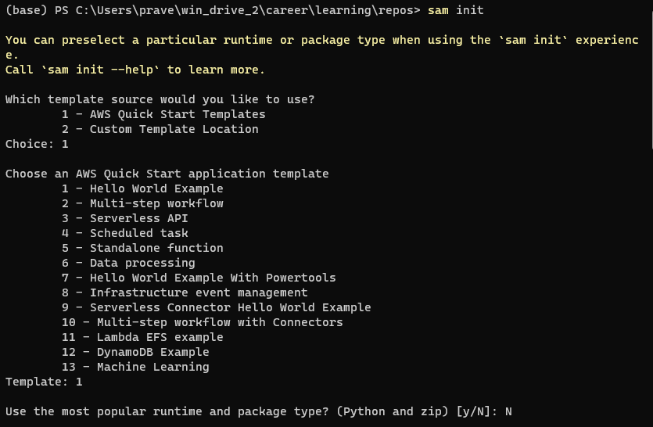
sam init guided choices to startup folder

Slide 9
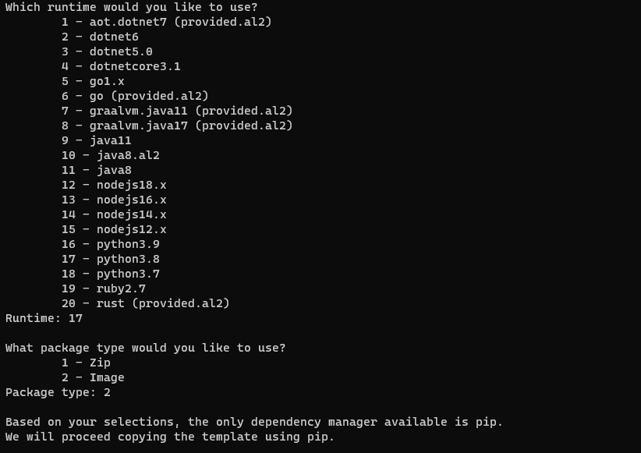
sam init guided choices to startup folder

Slide 10
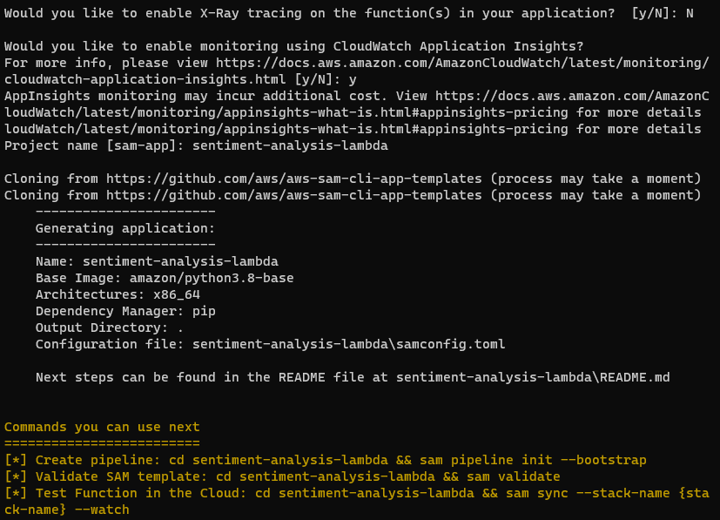
sam init guided choices to startup folder
XRay tracing - Troubleshoot Lambda function issues

Slide 11
After sam init
Modify following files (you can compare with my repo to see the modifications)
Template.yaml - template for creating AWS resources
App.py - has the lambda handler function and API
Requirements.py - python dependencies to install locally. Also, get installed in docker
Dockerfile - create docker container, copy model and download dependencies. Set Lambda handler as entry point function.
Create download_model.py - use this to download model from Hugging Face. Otherwise you can create your own
Use the reference below to make changes
References
https://github.com/praveen-taneja/sentiment-analysis-lambda - Let’s take a look at few of these especially app.py
https://docs.aws.amazon.com/serverless-application-model/latest/developerguide/using-sam-cli-init.html

Slide 12
Downloading the model
conda create -n sentiment_analysis python=3.8
conda activate sentiment_analysis
conda install pip (if not automatically installed)
pip install -r requirements.txt
python download_model.py

Slide 13

Deployment
sam build -
Downloads, installs, organizes code dependencies.
Prepares lambda code and docker image
Adds everything to .aws-sam/.build folder
sam local start-api - sets up the API for local testing eg using Postman
sam deploy - creates infrastructure on AWS
At the end gives out the API URL that can be used to send API requests to the model (using postman or webapp)
Testing using postman -
Request type = POST
Headers - leave as default
Body - choose raw option. {“message”: “I am feeling great!”}
Demo

Slide 14
Frontend - Web page hosting on S3
Manually create an S3 bucket (add index.html, CSS files), enable static website hosting,
References
https://youtu.be/n5XFPLo4Bbw?t=3270
https://github.com/praveen-taneja/api-frontend - front end code used for the demo. Remember to replace API url in index.html

Slide 15
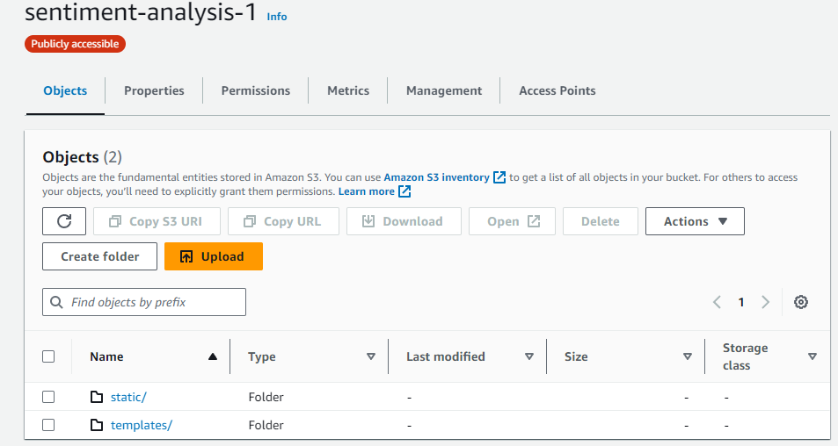
Webpage hosting on S3

Slide 16
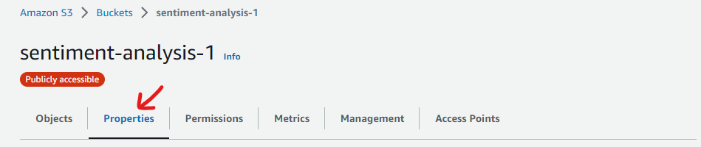
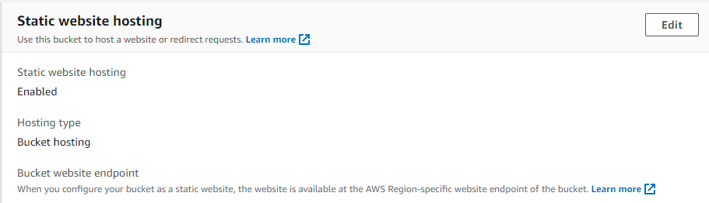
Webpage hosting on S3

Slide 17
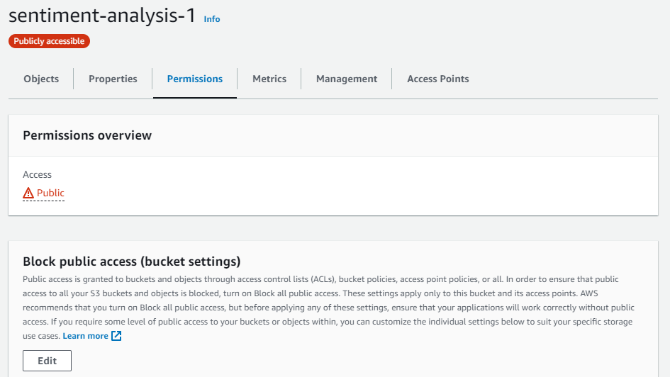
Webpage hosting on S3

Slide 18
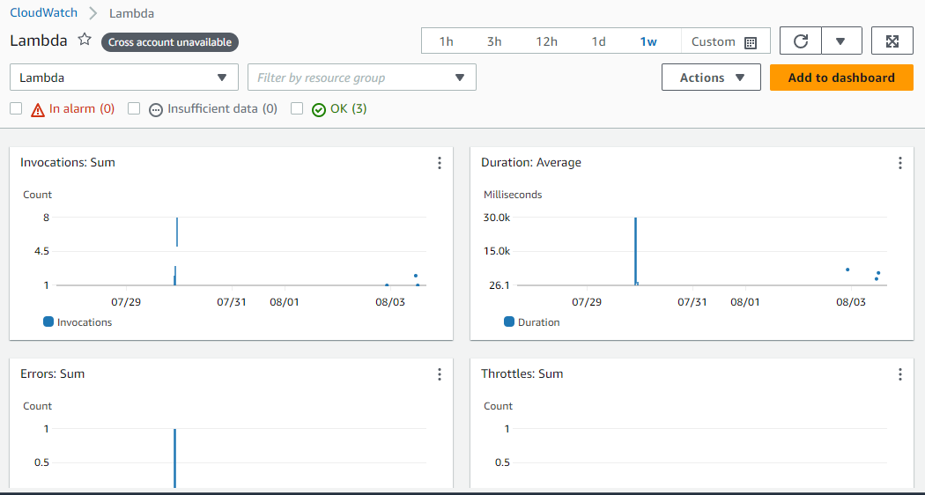
Monitoring via cloudwatch

